Slide 1
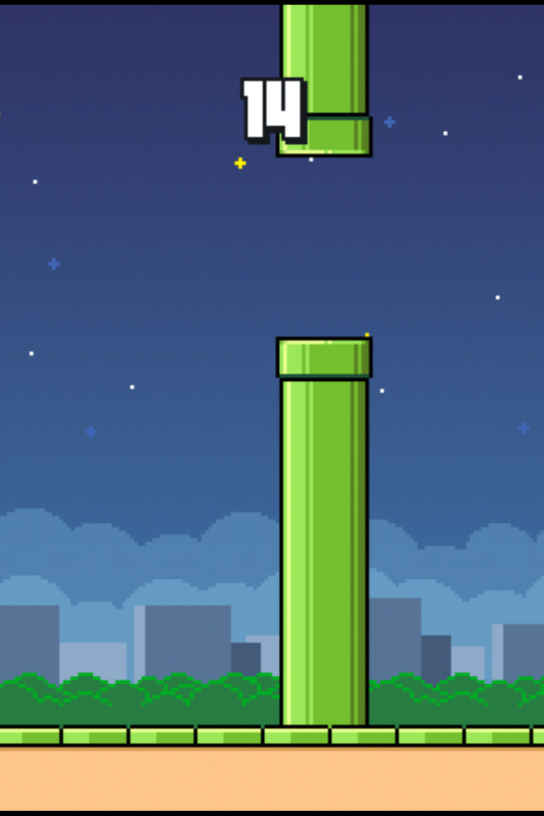
Flappy Bird Game in Java: An Elaborate Guide
Flappy Bird is a side-scrolling mobile game developed and published by Vietnamese game developer Dong Nguyen. The game was initially released on May 24, 2013, for iOS and later for Android. It became an overnight sensation and topped the charts in many countries.

Slide 2
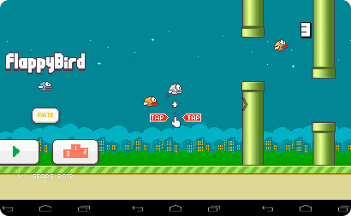
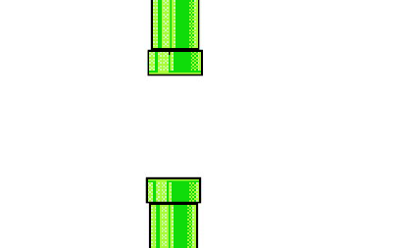
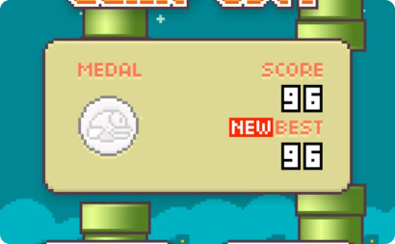
Overview of Flappy Bird Game
Flappy Bird is a simple game where you control a bird and try to keep it alive by flying it through pipes. The game is incredibly difficult and requires great hand-eye coordination. The graphics are simple but the challenge is addictive, making it a game that's easy to pick up but hard to put down.
Simple Gameplay
Challenging Obstacles
Competition and High Scores
Players tap the screen to flap the bird's wings, and the bird falls due to gravity.
Players must avoid the green pipes that appear on the screen by timing their flaps correctly.
Players compete with themselves and others for the highest score. The game saves the player's high score, adding to the game's replay value.

Slide 3

History and Popularity of the Game
Flappy Bird was a viral sensation, reaching the top of the App Store rankings in many countries shortly after its release. Despite being free to play, the game's developer was making around $50,000 a day from the advertising revenue generated by the game.
Accidental Fame
The game's developer, Dong Nguyen, had no idea his game would become so popular. He was working on it on the side while also developing other games.
Controversy and Removal
The game's sudden rise to fame was accompanied by controversy, and Nguyen removed the game from the App Store on February 10, 2014, citing the game's addictive nature.
Legacy and Clones
The game's legacy and impact can still be seen in modern mobile games. Several clones of the game have also appeared on the app stores, some even with the same name.

Slide 4

Gameplay Mechanics of Flappy Bird
The game's straightforward mechanics make it easy to learn but hard to master. There are a few key gameplay mechanics that players must master to do well in the game.
1
Timing of Flaps
Players must time their flaps perfectly to navigate the bird through the pipes. If they flap too much, the bird goes too high and hits the pipes. Flap too little and the bird falls to the ground.
Gravity and Speed
2
The bird is constantly falling, and players must control the speed of the bird's descent by flapping. The faster the bird flies, the harder it is to control.
3
Learning Curve
The game is challenging, but the learning curve is gradual. As players play the game, they get better at timing the bird's flaps, and their high scores improve.

Slide 5
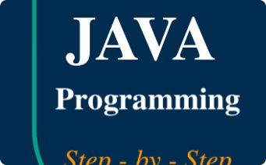
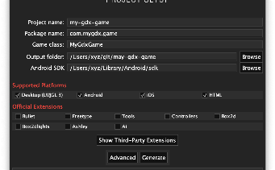
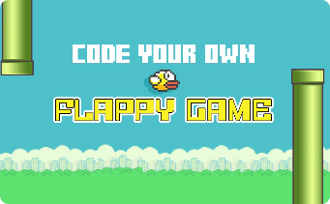
Development of Flappy Bird Game in Java
The Flappy Bird game was developed in Java and has since been recreated in several other programming languages as well. The game's simple graphics and mechanics make it an excellent project for learning to develop games in Java.
Introduction to Java Programming Language
Java Game Development Using Libraries
Step-by-Step Coding Process of Flappy Bird in Java
Java is a versatile and popular programming language that can be used to develop a wide range of applications. Java's garbage-collection feature and its platform independence make it an excellent choice for game development.
There are several libraries available in Java that can be used to develop games. LibGDX is one of the most popular libraries for game development in Java. It provides a simple way to create games that run on multiple platforms.
The code for Flappy Bird in Java is available on GitHub, and it's a great resource for learning game development in Java. The code is well-documented and explains every step of the process.

Slide 6

Additional Features in the Java Version of Flappy Bird
The Java version of Flappy Bird has several additional features that make it fun to play and customize.
1
Customizing the Game's Appearance and Graphics
2
Implementing Different Difficulty Levels
3
Adding Sound Effects and Music to the Game
Players can change the bird's appearance and the graphics of the game to their liking, making it a fun way to personalize the game.
The game can be made more challenging by adding more pipes or obstacles. Players can also choose the difficulty level themselves.
Adding sound effects and music to the game can make it more immersive and enjoyable to play. Java provides several libraries for adding audio to games.

Slide 7
Conclusion and Future of Flappy Bird in Java
The Flappy Bird game is a classic example of a simple idea executed well. The game's popularity has resulted in several clones and recreations in different programming languages, including Java. There is an opportunity to add new features and make the game even better.
Summary of the Presentation
Challenges and Future Improvements for the Game
Q&A Session and Discussion
Flappy Bird is a simple but challenging game that grabbed the world's attention in 2013. The game's simple graphics and mechanics make it an ideal project for learning to develop games in Java and other programming languages.
Questions and discussion about the Flappy Bird game and game development in Java are welcome.
The Flappy Bird game's addictive nature and sudden rise to fame made it a controversial topic. The game's difficulty level can be adjusted, and new additional features added. There is a lot of room for improvement and expansion of the game in the future.

